Slide 1
Linguistics 201
Phonetics 2
Francisco Torreira

Slide 2
Today
Classes of speech sounds (see O&A 2.3)
Consonants vs. vowels
Describing consonants
Voicing (see O&A 2.2.3)
Place of articulation (see O&A 2.4)
Manner of articulation (see O&A 2.5)

Slide 3
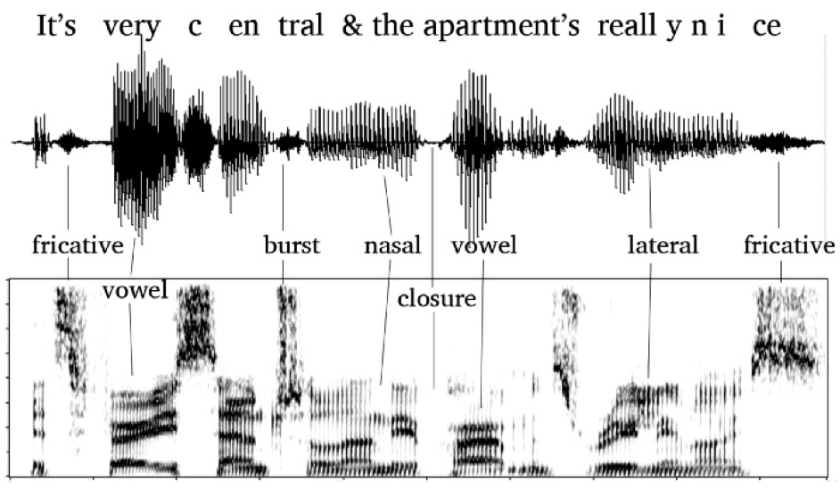

Speech segmentation
Amplitude
vowel
ɪ t s v ɛ ɹ i s ɛ ntɹ l̩ æn ðiə p^{h} ɑɹtmənts ɹ i l i n aj s
Frequency
>> Time >>

Slide 4
Speech sounds
In speech production, humans make two broad types of speech sounds (i.e. segments)
Vowels
Consonants
What’s the difference?

Slide 5
Articulatory differences:
Consonants: constriction in vocal tract
Vowels: open vocal tract
Aerodynamic differences:
Consonants: no or turbulent airflow
Vowels: laminar airflow

Slide 6
Acoustic differences:
Consonants: less acoustic energy (than vowels), may involve intervals of silence or noise
Vowels: more acoustic energy, no noise
ɪ t s v ɛ ɹ i s ɛ ntɹ l̩ æn ðiə p^{h} ɑɹtmənts ɹ i l i n aj s

Slide 7
IPA consonants
Place of articulation
coronal
Manner of articulation
https://www.internationalphoneticassociation.org/sites/default/files/IPA_Kiel_2015.pdf
https://www.seeingspeech.ac.uk/ipa-charts/
Notes:
All possible consonant types observed in languages, greyed out areas judged impossible for articulatory reasons
Arranged along three dimensions, more on this later
No language contrasts dental vs alveolar or postalveolar, hence the grouping in only one column on the IPA.
French And Sp have dental coronals (d, t, n), but English counterparts are alveolar, not dental.

Slide 8
English consonants on the IPA
*
*
* - labial = bilabial
- palatoalveolar = postalveolar
- for [θ] and [ð]: dental = interdental
Notes:
Subset of IPA needed to transcribe English words
In this class we use these symbols to transcribe English consonants
Discussion over following slides

Slide 9
English consonants on the IPA

Slide 10
English consonants on the IPA
A note on [ɹ] :
Linguists often use the symbol [r] for the “r” sound, for convenience
[ɹ] is the IPA symbol for North American English!
On the IPA, [r] is a trill (like Spanish carro)
We will use [ɹ]
Some speakers use a retroflex place of articulation

Slide 11
English consonants
Notes:
- Watch out, orthography can be misleading

Slide 12
Describing consonants
Consonants are classified by their:
Voicing
Place of articulation
“Where” pronounced*
Manner of articulation
“How” pronounced
e.g. [p] is a voiceless bilabial stop
* Not exactly: see slide 15

Slide 13
2. Place of articulation
left/right: voiceless/voiced
1. voicing
3. Manner of articulation
IPA chart organized by 3 parameters
describing consonants

Slide 14
Dimension 1: Voicing
Consonants can be:
Voiced
Vocal folds are brought together and air is passed through them creating a vibration)
Voiceless
Vocal folds are held apart; air passes through freely, no vibration

Slide 15
Dimension 2: Place of articulation
Different speech sounds: move structures of the vocal tract into different configurations
Place of articulation: point of contact between specific active and passive articulators e.g.
lower and upper lip: bilabial
tongue blade and alveolar ridge: alveolar
underside of tongue tip and palate: retroflex
back of tongue and velum: velar

Slide 16
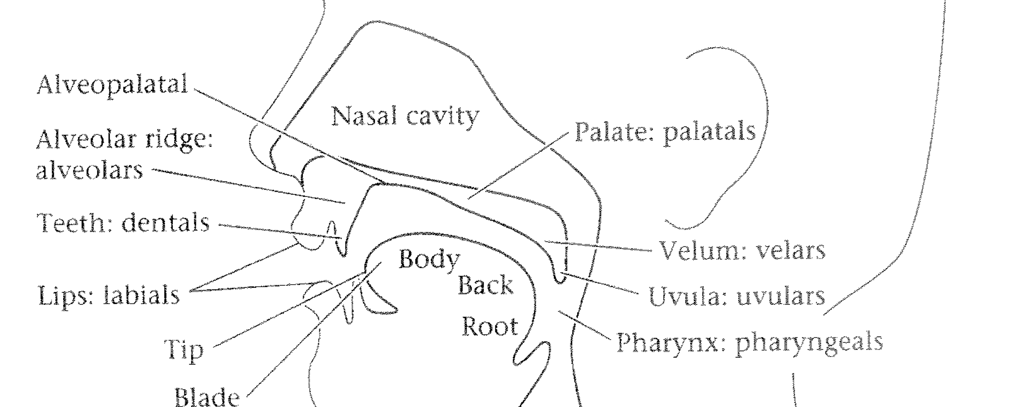
Some articulators and places of articulation (underlined)
Notes:
articulators and their places (underlined)

Slide 17

Places of articulation
Place | example
(bi)labial | b
labiodental | v
interdental | θ
alveolar | s
alveopalatal | ʃ
palatal | j
velar | ɡ
uvular | ʁ (French) q (Inuktitut)
pharyngeals | ħ (Haida)
glottal | h
Some articulators and places of articulation (underlined)

Slide 18
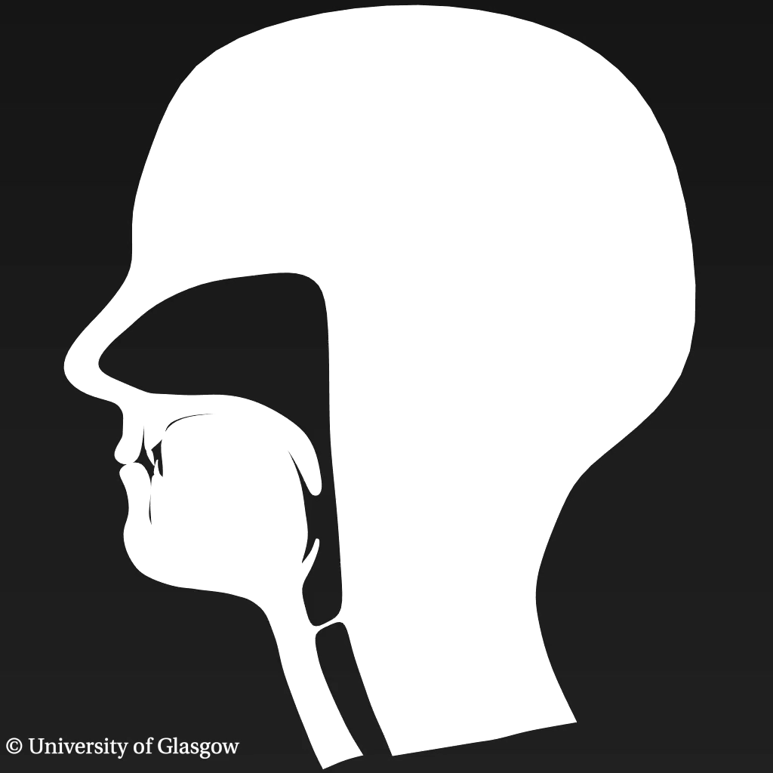
Seeing speech
[b]
voiced bilabial stop

Slide 19
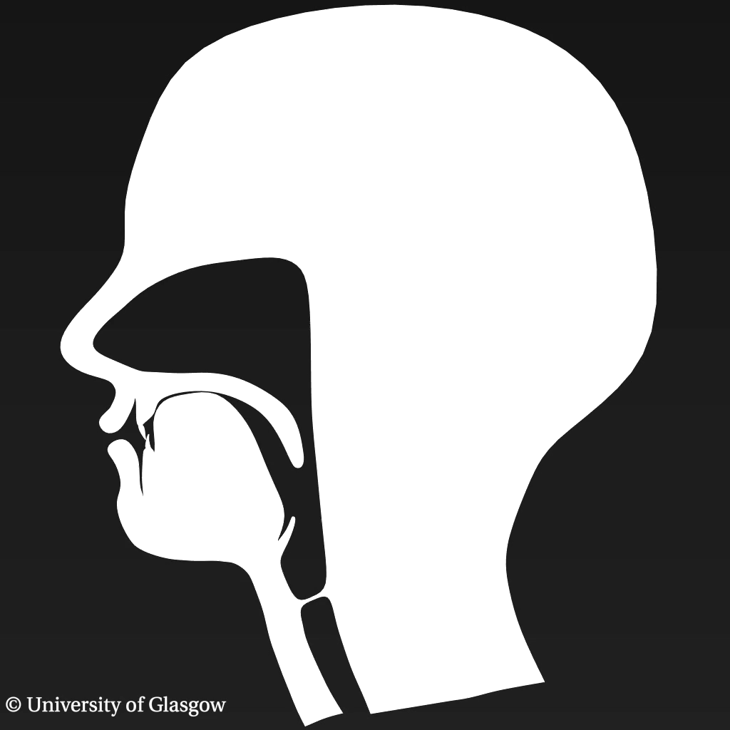
[v]
voiced labiodental fricative

Slide 20

[θ]
voiceless (inter)dental fricative

Slide 21
Dimension 3: Manner of articulation
How the consonant is produced:
degree or nature of the constriction
the type/shape of resonator

Slide 22
Dimension 3: Manner of articulation
Different ways of producing a consonant:
Stops: Stopping airflow: [p b t d k ɡ]
Fricatives: Constricting airflow to create turbulent noise [f v θ ð s z ʃ ʒ h]
Nasals: Diverting airflow to another resonator (nasal cavity) [m n ŋ]
Approximants & laterals: Dramatically changing the oral cavity resonator [ɹ/r/l]

Slide 23
Stops
a.k.a plosives
complete constriction, blocked oral airflow, short turbulent release
Three stages
approach (= onset)
hold (= closure)
release
[ɑ b ɑ]
Notes:
test on this!

Slide 24
Amplitude
vowel
ɪ t s v ɛ ɹ i s ɛ ntɹ l̩ æn ðiə p^{h} ɑɹtmənts ɹ i l i n aj s
Frequency
>> Time >>

Slide 25
Stops
Notes:
- Most places of articulation, voiced and voiceless exceot for glottal, why?

Slide 26
Aspiration
Voiceless stops in English are often aspirated*
Release of stop closure followed by burst of air
Aspiration transcribed with superscript “h”
[p^{h}], [t^{h}], [k^{h}] (pin, tin, kiss)
versus: [p], [t], [k] (spin, stick, ski)
* we’ll come back to what “often” means in Phonology unit
Notes:
you can feel the aspiration
- Show example in Praat

Slide 27
Fricatives
Narrow constriction + high air volume velocity > turbulent airflow, which we perceive as noise
[ɑ s ɑ]

Slide 28
Amplitude
vowel
ɪ t s v ɛ ɹ i s ɛ ntɹ l̩ æn ðiə p^{h} ɑɹtmənts ɹ i l i n aj s
Frequency
>> Time >>

Slide 29
Fricatives
Notes:
- All places of articulation! Voiceless and voiced.

Slide 30
Affricates
Can be understood as a stop + fricative in fast succession. = stop with slow release
Always transcribed as stop + fricative
often using tie bar: [t͡ʃ], [d͡ʒ] , to differentiate from [t] + [ʃ]
nutshell vs. ratchet
This class: either [t͡ʃ] or [tʃ] OK for affricate

Slide 31
Dimension 3: Manner of articulation
Different ways of producing a consonant:
Stops: Stopping airflow: [p b t d k ɡ ʔ]
Fricatives: Constricting airflow to create turbulent noise [f v θ ð s z ʃ ʒ h]
Nasals: Oral stop + diverted airflow to another resonator (nasal cavity) [m n ŋ]
Approximants, lateral approximants: Partial constriction without turbulence [ɹ/r/l]

Slide 32
Nasals
In most speech, the soft palate is raised
Nasal consonants (e.g. [n], [m]) require a lowered velum
During the production of nasal consonants, oral cavity if closed: air flows through nasal cavity

Slide 33
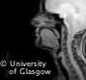
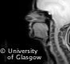
Nasals
vs.
[m]
/b/
Notes:
velum action during labial closure in [m]
Other than that, identical articulation as [b]

Slide 34
Nasals
Notes:
- All places of articulation! Voiceless and voiced.

Slide 35
Dimension 3: Manner of articulation
Different ways of producing a consonant:
Stops: Stopping airflow: [p b t d k ɡ ʔ]
Fricatives: Constricting airflow to create turbulent noise [f v θ ð s z ʃ ʒ h]
Nasals: Oral stop + diverted airflow to another resonator (nasal cavity) [m n ŋ]
Approximants, lateral approximants: Partial constriction without turbulence e.g.
[l]: constriction in oral cavity, but air passes through one or two sides of tongue
[j], [w] involve narrow constrictions, but involve no turbulent airflow

Slide 36
Consonants: Summary
Consonants are classified by their:
Voicing
Glottal state e.g. voiced vs. voiceless
Place of articulation
“Where” pronounced*: e.g. bilabial vs velar
Manner of articulation
“How” pronounced e.g. stop vs fricative
e.g. [p] is a voiceless bilabial stop

